Slide 1
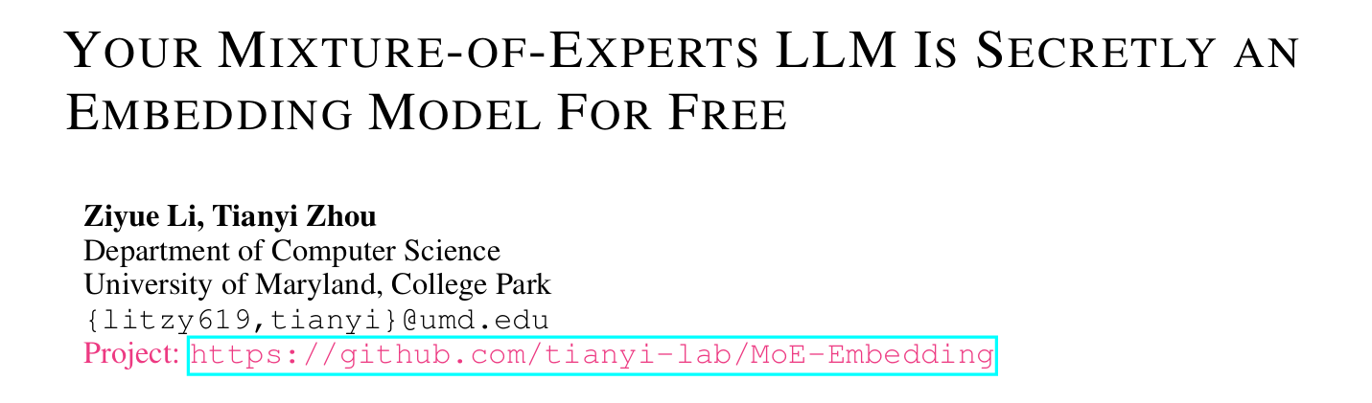
ICLR25：6，6，8

Slide 2
Motivation:
most recent LLMs and MoE LLMs are built upon the decoder-only architecture trained for autoregressive next-token prediction. While excelling on generative tasks, their final or intermediate hidden state (HS) is not designed to capture the key features of input tokens and cover all their information. Instead, HS can be biased towards the information of the next output token.
Although it is a common empirical practice to extract the last token’s hidden state (HS) as embedding (Wang et al., 2024), it may even perform much poorer than smaller encoder models specifically trained for embedding tasks.
Can we extract high-quality embedding directly from LLMs without additional training?
Our main discovery is that the routers in MoE can serve as an off-the-shelf embedding model and the produced routing weights (RW) provide complementary information to the widely used HS as embedding.
Compared to HS focusing on the final prediction results from the input, RW reflects the interme diate reasoning choices of MoE on the input for each layer of LLMs

Slide 3
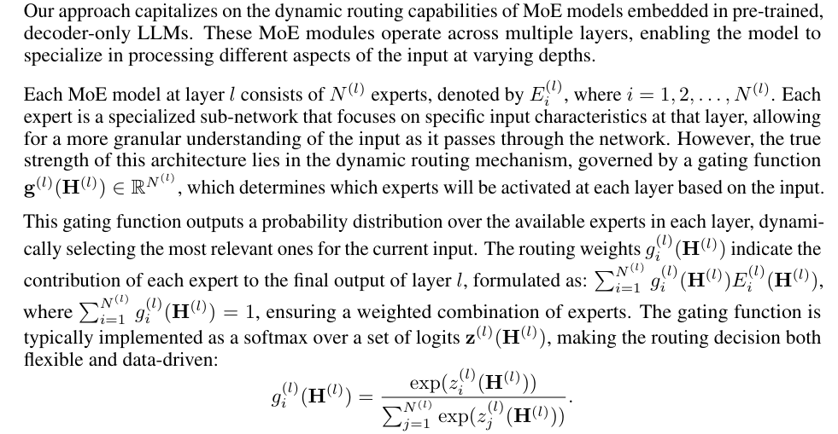
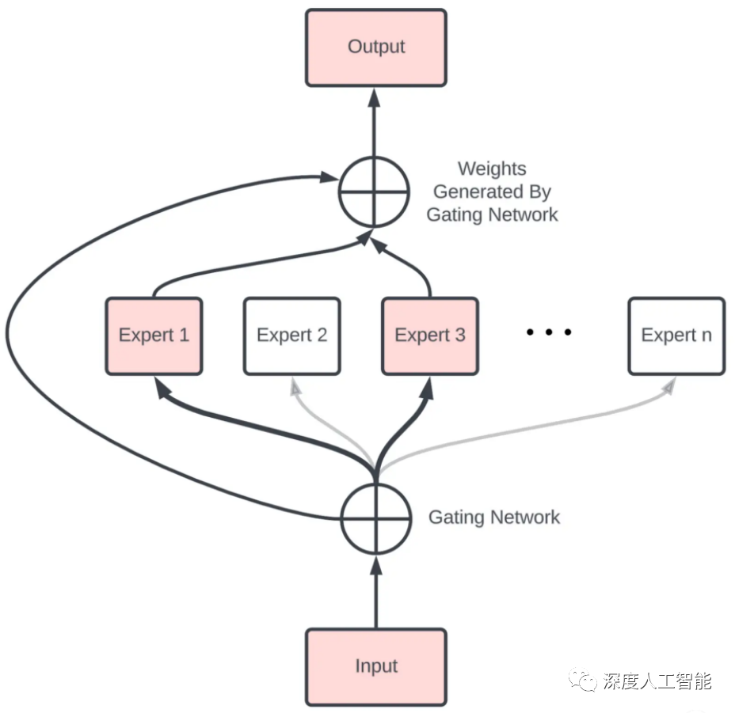


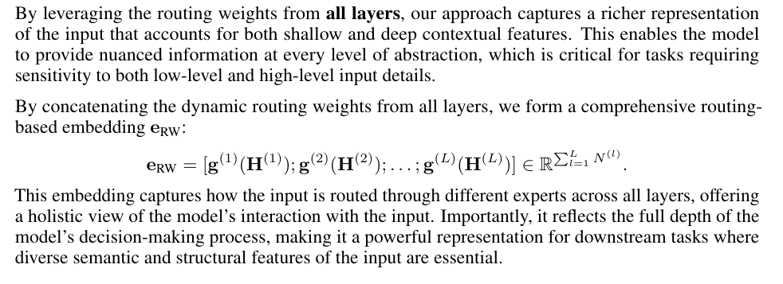

$$H^{(l)}$$

Slide 4
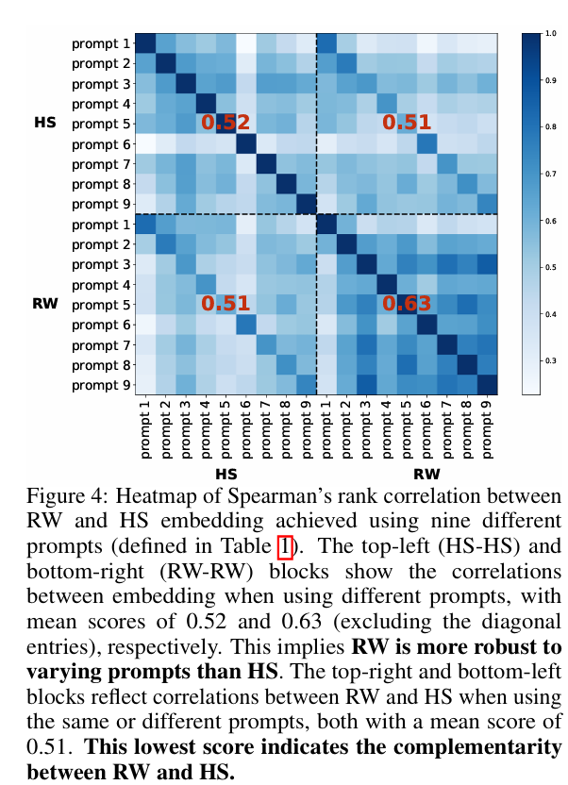
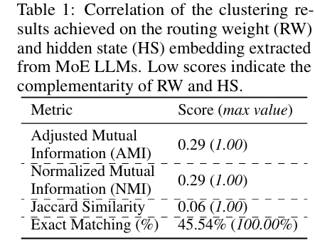
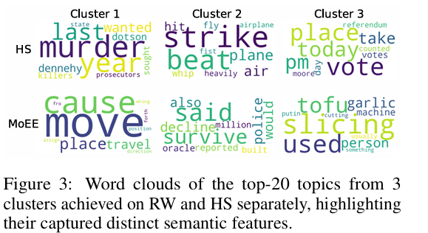
探究RW和HS的差异和互补性
While HS embedding from pre-trained LLMs provides a broad, context-driven representation of sentences, they may overlook the nuanced, token-specific information that RW embedding can capture through MoE’s dynamic routing.
conducting a Spearman correlation analysis using the STS12 dataset, which contains 6,216 sentence pairs.
For each pair, we generate embedding from both RW and HS and calculate the similarity between the sentences to assess how each embedding captures semantic relationships
To ensure that any observed differences are not caused by prompt variation, we employ nine distinct prompts
Notes:
AMI：衡量两个变量之间的相互依赖程度
Jaccard：通过计算两个集合交集的大小与并集的大小之比来衡量集合间的相似性
精确匹配：指的是数据点被两种不同方法（RW 和 HS 嵌入）划分到完全相同聚类中的比例
BERTopic framework来进行每个簇的主题分析
HS-HS/RW-RW：较高的 RW - RW 相关性均值表明，与 HS 相比，RW 在面对不同提示时，其嵌入结果更为稳定，即 RW 对提示变化的鲁棒性更强。这意味着不同的提示对 RW 嵌入结果的影响相对较小，而 HS 嵌入结果受提示变化的影响相对较大。

Slide 5

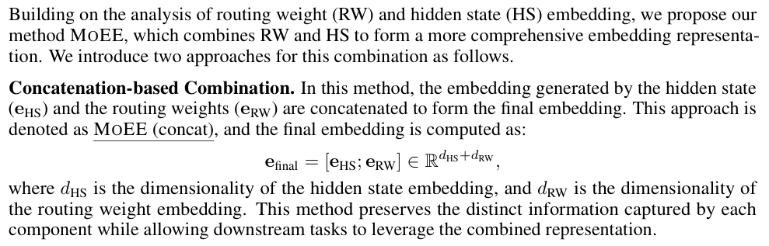
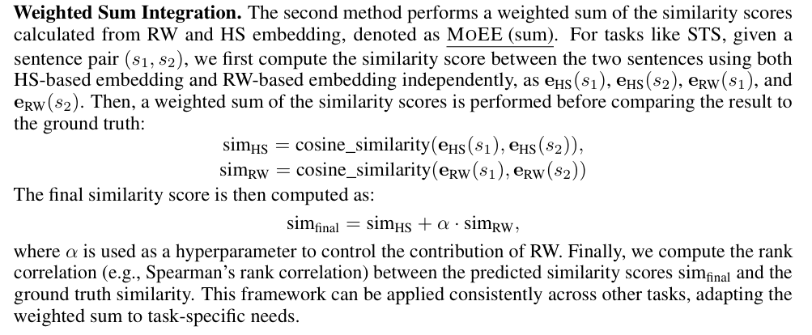
Notes:
在测试时用基于梯度的方法自适应调整，使组合相似性与各组件相关性最大化

Slide 6
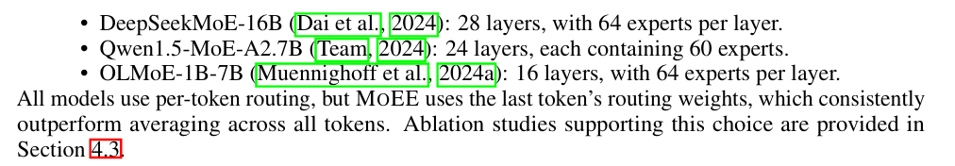
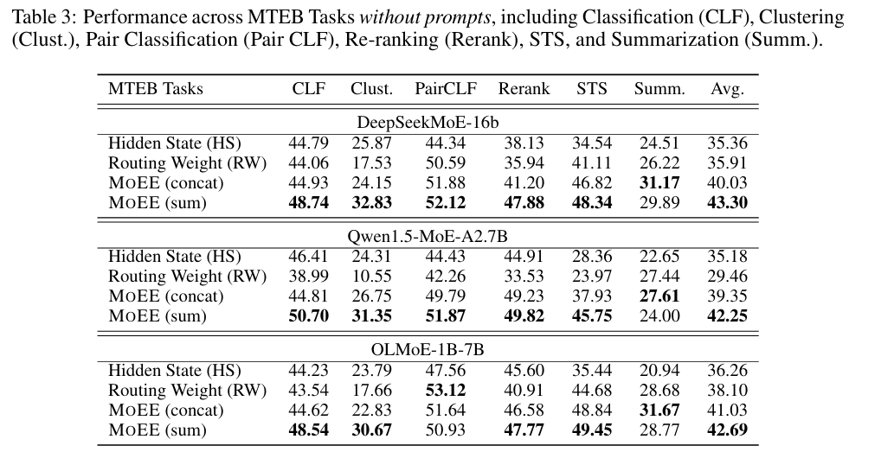
EXPERIMENTS

Slide 7
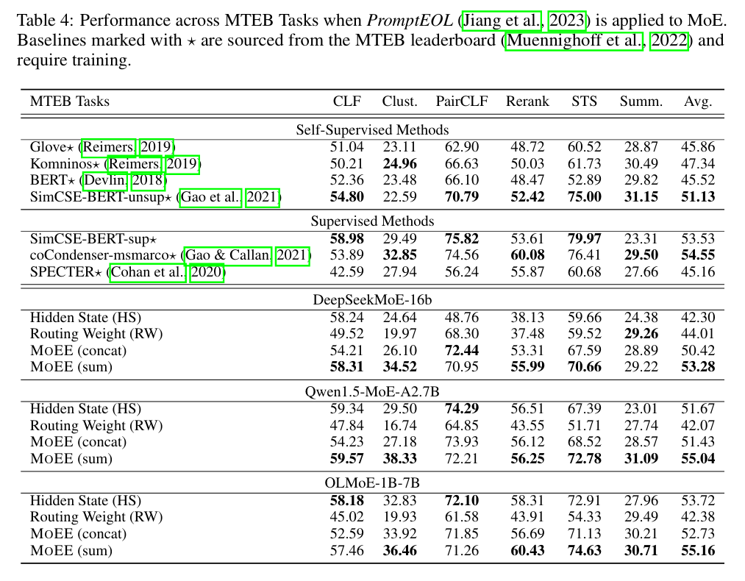
+ promptEOF：“This sentence: ‘[text]’ means in one word: ”
Notes:
promptEOF引导模型将输入句子的含义浓缩为一个单词的表达形式。用于提升句子嵌入的性能
GloVe（Global Vectors for Word Representation）是一种无监督学习算法，用于获取单词的向量表示。是Word2Vec模型的扩展.
Komninos: Sentence-bert
SimCSE:对比学习。用于句子嵌入的对比学习方法
coCondenser-msmarco：

Slide 8
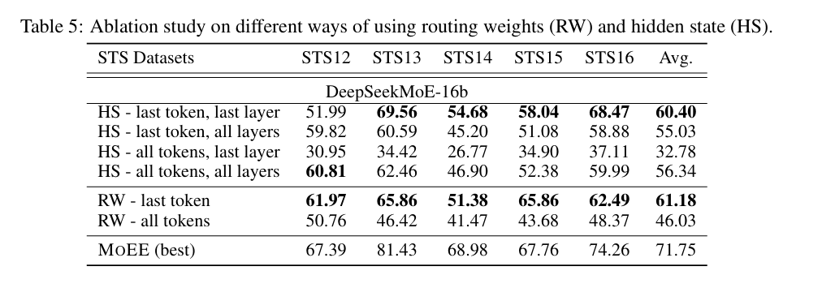
While HS embedding from pre-trained LLMs provides a broad, context-driven representation of sentences, they may overlook the nuanced, token-specific information that RW embedding can capture through MoE’s dynamic routing.
Notes:
路由权重（RW）整合了所有层的路由决策，能够捕捉多个深度的信息。相比之下，仅来自最后一层的隐藏状态（HS）可能会遗漏重要的中间细节。因此，我们评估了使用所有层的隐藏状态（HS - 最后一个标记，所有层），以查看它是否能与自然利用多层信息的 RW 相媲美

Slide 9
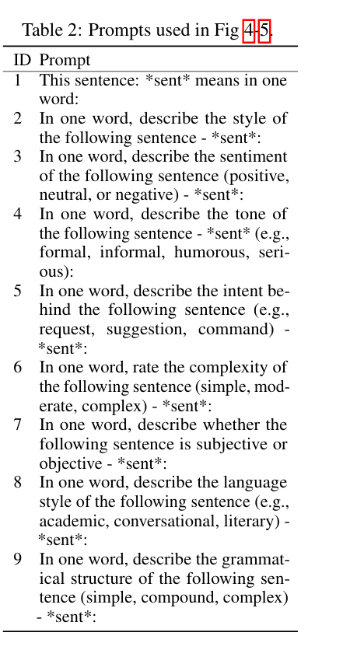
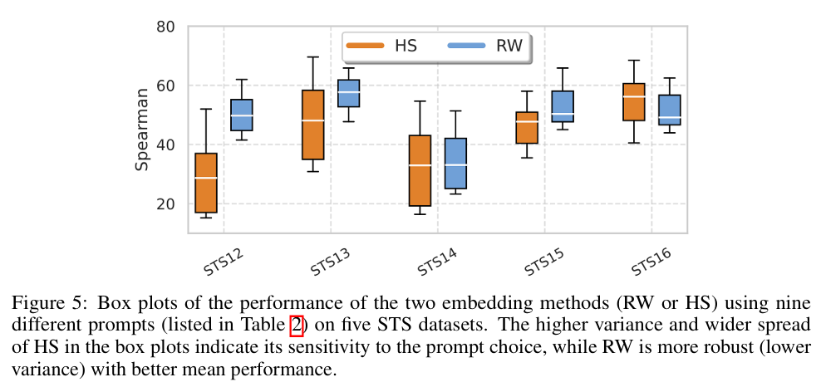
To assess the prompt sensitivity of RW and HS, we measure their Spearman correlation scores across STS12-16 datasets using 9 different prompts listed in Table 2.
We then compute the mean and variance of these scores for each dataset, capturing how performance fluctuates under different prompt conditions and whether the methods remain stable when exposed to prompt variations
Notes:
均值反映了整体的平均性能
RW 表现出更高的稳定性，在所有数据集中方差始终较低，箱线图更窄，这表明它对提示的选择具有稳健性水平，方差则衡量了性能围绕均值的离散程度，方差越大，说明性能受提示变化的影响越大，对提示越敏感。

Slide 10
To assess the prompt sensitivity of RW and HS, we measure their Spearman correlation scores across STS12-16 datasets using 9 different prompts listed in Table 2.
We then compute the mean and variance of these scores for each dataset, capturing how performance fluctuates under different prompt conditions and whether the methods remain stable when exposed to prompt variations
Notes:
均值反映了整体的平均性能
RW 表现出更高的稳定性，在所有数据集中方差始终较低，箱线图更窄，这表明它对提示的选择具有稳健性水平，方差则衡量了性能围绕均值的离散程度，方差越大，说明性能受提示变化的影响越大，对提示越敏感。

Slide 11
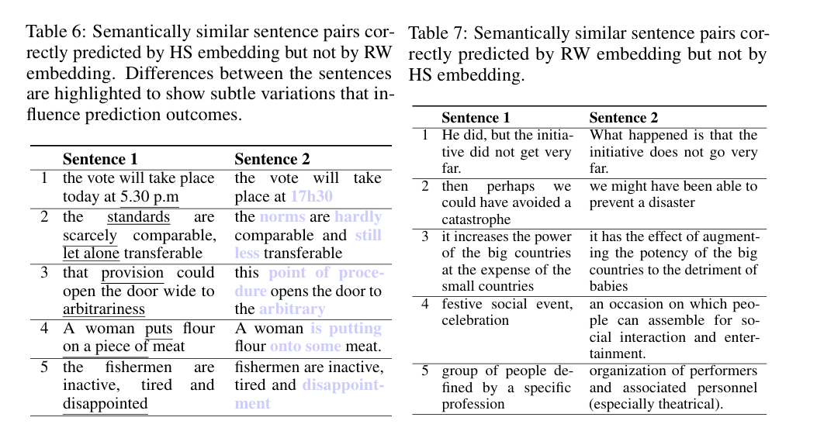
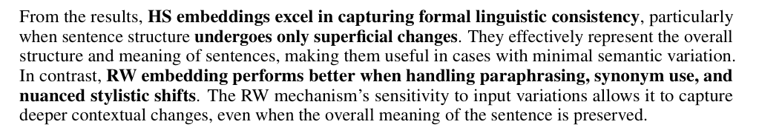
Notes:
路由权重（RW）整合了所有层的路由决策，能够捕捉多个深度的信息。相比之下，仅来自最后一层的隐藏状态（HS）可能会遗漏重要的中间细节。因此，我们评估了使用所有层的隐藏状态（HS - 最后一个标记，所有层），以查看它是否能与自然利用多层信息的 RW 相媲美

